Slide 1
SBTi- Finance
Webinar with Standard Chartered
June 21st, 2019

Slide 2
Today’s Speakers
Cynthia Cummis
Director of Private Sector Mitigation
World Resources Institute
Simon Connell
Head of Sustainability Strategy
Standard Chartered

Slide 3
Agenda
Topic | Time
Road testing project updates | 10 min
Sharing from Standard Chartered | 30 min
Discussion and Q&A | 30 min
Wrap up | 5 min

Slide 4
Q&A
This webinar is being recorded and the recording will be shared publicly.
To ask questions, please type them into the Q&A box or raise your hand to speak.
Notes:
CONTENT

Slide 5
Road testing project updates
Launch webinar
April 25
Road testing period
April – end of July
Workshops to discuss feedback
September
We recently sent out a simpler survey for broad stakeholders to provide general feedback. Road testers: please fill out the correct survey via SurveyGizmo to provide in-depth feedback.
Survey deadline extended to July 31st responding to road testers’ feedback
Upcoming webinar with ASN Bank and Navigant on June 24th about the SDA for mortgage method. An email invitation was sent out to all road testers. Please register at this Zoom link to participate and access the recording.
Notes:
Cynthia to discuss

Slide 6
Next steps: Workshop at Climate Week NYC in September
Launch webinar
April 25
Road testing period
April – end of July
Workshops to discuss feedback
September
Road testing feedback summary workshop during New York Climate Week this September 24-30. Stay tuned for the invite!
Notes:
Cynthia to discuss

Slide 7
No-cost default data option
We thank ISS ESG, who generously offered to provide off-the-shelf datapoints to interested road testers free of charge. Certain limitations might be applied.
Data can only be used internally, for a limited time and for road testing only. Users need to sign a respective agreement.
Free data comes “as is” - advice or bespoke research can be added on a ‘for pay’ basis.
Other data providers can provide data and assistance for a fee.
If you need data support, please direcly contact:
Joseph Ben Salem ISS
+44 (0) 203 192 5755 joseph.bensalem@issgovernance.com
Notes:
Cynthia to discuss

Slide 8
Key team contacts for questions
For questions related to the SBT Portfolio Coverage method for corporate instrument, the road testing process, and the Science Based Targets initiative, please contact Nate Aden, Senior Fellow, World Resources Institute, nate.aden@wri.org or Chendan Yan, Research Analyst, World Resources Institute, chendan.yan@wri.org.
For questions related to the other emissions based approaches, please contact Giel Linthorst, Director, Navigant giel.linthorst@navigant.com or Kaboo Leung. Senior Consultant, Navigant, kaboo.leung@navigant.com
For questions related to the technology based approaches, please contact Florence Palandri, Analyst, 2° Investing Initiative, florence@2degrees-investing.org, +44 77 08 32 90 90
2° Investing Initiative also provides free, online, fully automated equity and bond portfolio analysis (www.transitionmonitor.com)
The team provides a desktop software version for assessing loan books and PE. The software and related support service are provided free of charge.
The underlying data covering about 52,000 legal entities (issuers and their subsidiaries) is provided as part as the analysis of the portfolio
Notes:
Cynthia to discuss

Slide 9
After road testing - criteria discussion and consultation
While the road test focuses on target setting methods for portfolio alignment,
we will address the role of action targets and divestment when we prepare the target validation criteria document for consultation.
We are here
Commit to SBTi at Institutional Level
Asset Class Materiality Assessment
Portfolio Alignment Hotspot Assessment
Set SBTs at Asset Class Level
Real Estate
Mortgage
Electricity Generation Project Finance
Corporate Equity and Debt
To be refined after road testing
Take Action
Investee engagement (ACT initiative, CA100+, SBTi)
Sustainable real asset (GRESB)
Sector standards
Notes:
Cynthia to discuss

Slide 10
Standard Chartered SBTI Roadtest Experience
June 2019

Slide 11
Context to target setting

Slide 12
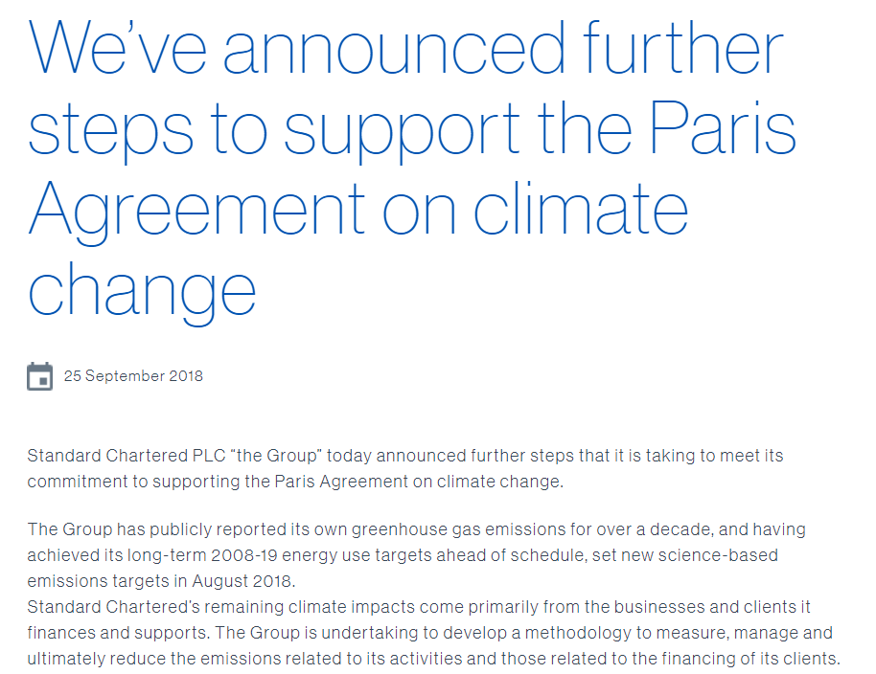
Initial commitment…

Slide 13
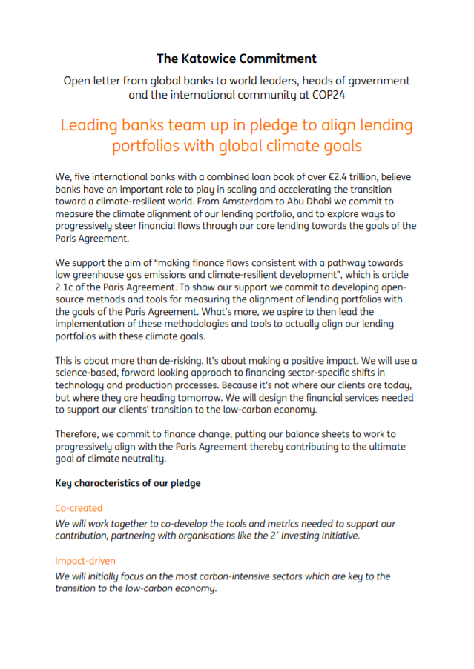
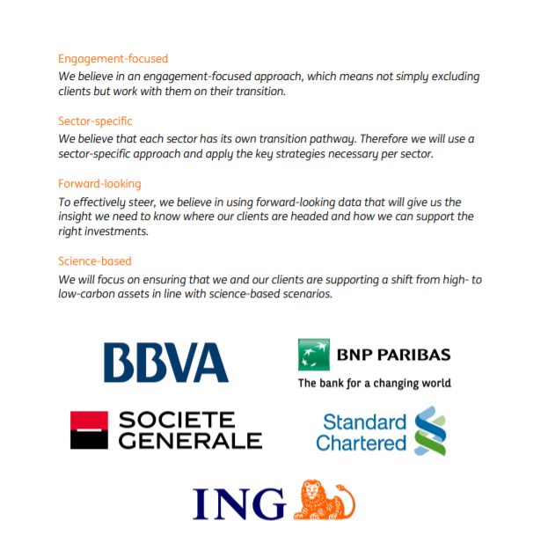
…and the coalition

Slide 14
Testing

Slide 15
The how
Cross-functional team, including those involved in prior climate work:
Sustainability
Enterprise Risk
Portfolio management
Credit Risk
Project Finance
Sector lending teams
Working on both SDA and PACTA in parallel
Regular update meetings
Targeted client engagement throughout; validate outputs
Reporting upward to Management Team and Board, especially as we approached white paper publication

Slide 16
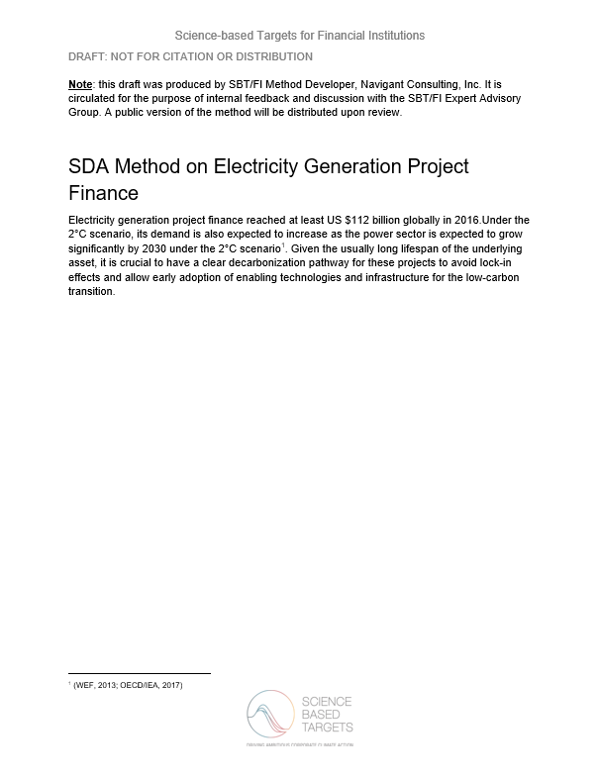
Sectoral Decarbonisation Approach (SDA)
Benefits from simplicity and scalability
Requires input emissions data
Started with Project Finance portfolio; relevance to our business and strategy, and anticipated access to data
Method also readily understandable for stakeholders
Used multiple sources for data collation:
Initial project design documents
Project reporting
Public source review
Data availability still a challenge in our markets, especially for older projects
Averages or proxies present different challenges
Still working on this challenge

Slide 17
Paris Agreement Capital Transition Assessment
‘One stop’ solution…
…but which needs acknowledged support to apply at present
Integrated approach presents significant benefits in speed of analysis
Also requires careful review of underlying inputs and assumptions
Allowed us to generate insights we are already using in our decision-making

Slide 18
Engagement and next steps

Slide 19
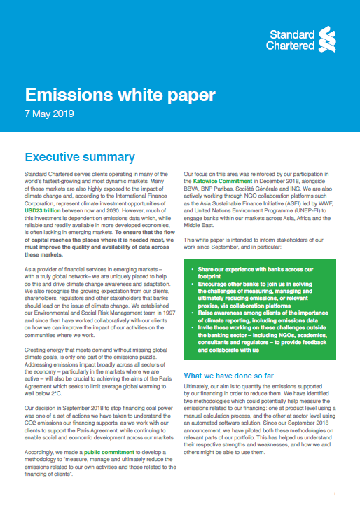
Emissions white paper
Sets out our experience with SDA and PACTA
Acknowledge methods need further development; aiming to raise awareness across our footprint
Enabled targeted engagement, and looking for opportunities to continue this
Sets out a series of calls to action

Slide 20
Our calls to action
Clients
Bring forward climate reporting and emissions data
Banks
Help solve the challenge of measuring financed emissions
NGOs. Academics
Support solutions development
Regulators
Think about how this can integrate into regulatory practices
Give feedback

Slide 21
Q&A
To ask questions, please type them into the Q&A box or raise your hand to speak.
Notes:
Cynthia to discuss

Slide 22
www.sciencebasedtargets.org
info@sciencebasedtargets.org

